Slide 1
Introduction to GIS and StoryMaps Workshop
Harriett Green and Nicholas Weber
University of Illinois at Urbana-Champaign
Data Driven Scholarship Autumn Institute
University of Hong Kong, November 28-30, 2016

Slide 2
Today’s Workshop
SLIDE AND WORKSHOP MATERIAL CREDITS:
James Whitacre, GIS Specialist at University of Illinois
Brief Introduction to GIS
Introduction to GIS tools
Activity: Create and work with Story Maps
Examples of Mapping and GIS projects
http://guides.library.illinois.edu/gis

Slide 3
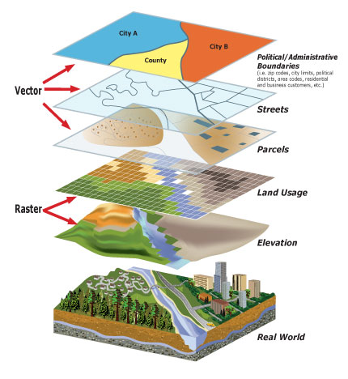
What is GIS?
Geographic Information System or Science
With GIS data, you can analyze and visualize places in relation to each other, over time, and from many different perspectives

Slide 4
What Is Geographic Information?
Information about places on the Earth's surface
Knowledge about where something is
Knowledge about what is at a given location
Source: Goodchild, M. F. 1997. “What is Geographic Information Science?, NCGIA Core Curriculum in GIScience”. Last modified October 7. http://www.ncgia.ucsb.edu/giscc/units/u002/u002.html.

Slide 5
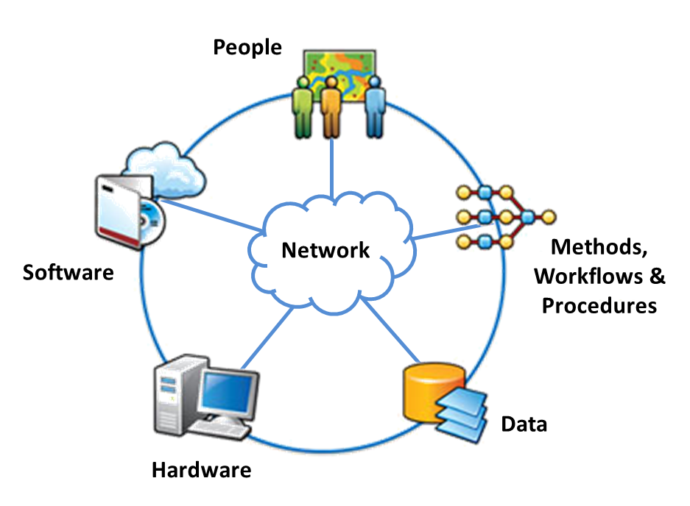
Geographic Information System
Integrates hardware, software, data, people, and workflows to capture, manage, analyze, and display many forms of geographic information
View, understand, question, interpret, and visualize data in many ways that reveal relationships, patterns, and trends in the form of maps, globes, reports, and charts.
Answer questions and solve problems by looking at your data in a way that is easily understood and shared.
Source: Esri. 2014. “GIS - GIS Dictionary”. Accessed August 4. http://support.esri.com/en/knowledgebase/GISDictionary/term/GIS.

Slide 6
Who is using GIS?
Social Sciences
Political Science
Social Work
Sciences
Biology
Engineering
Humanities
History
Journalism
Business and Economics
Education
Public administration
Urban planning
Literature
Criminology
Library and information science
Medicine
Atmospheric Sciences
Agriculture
Environmental Sciences
Geology
Archaeology
Anthropology

Slide 7
Who is using GIS?
Biology, ecology, environmental sciences, forest science, geology, engineering, history, archeology, anthropology,
literature, political science, business, economics, public health, medicine, education, public administration, geography, agriculture, urban planning, atmospheric sciences, library and information science, journalism, veterinary medicine, social work, criminology…

Slide 8
Geographic Data
Geographic and spatial data is not flat, but multi-layered
Several aspects required to understand geographic characteristics of a place or object

Slide 9
Layers in GIS data
Visual representation of a geographic dataset in a map
Collection of similar or thematic geographic features
All features must be the same type of data (point, line, polygon, raster) and share the same set of attribute types (or fields).
Examples: mountain peaks, roads, lakes, elevation
Defines visualization properties or symbology
In GIS software, they do not store data, but reference (i.e. point to) data sources

Slide 10
Features
Where something is…
Can be shown on a map
If data has a location info (eg. latitude and longitude) it is considered geographic/spatial
Examples: Streams, boundaries, nesting locations, hillshades

Slide 11
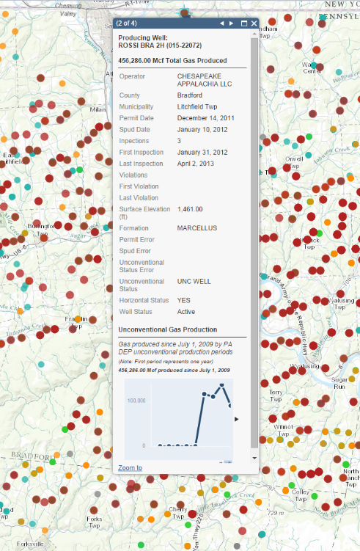
Attribute Information
Attribute information describes what something is…
Describes the spatial information/features using data tables
Connected to the features by a data table
Examples: Stream length, boundary name, nest species.

Slide 12
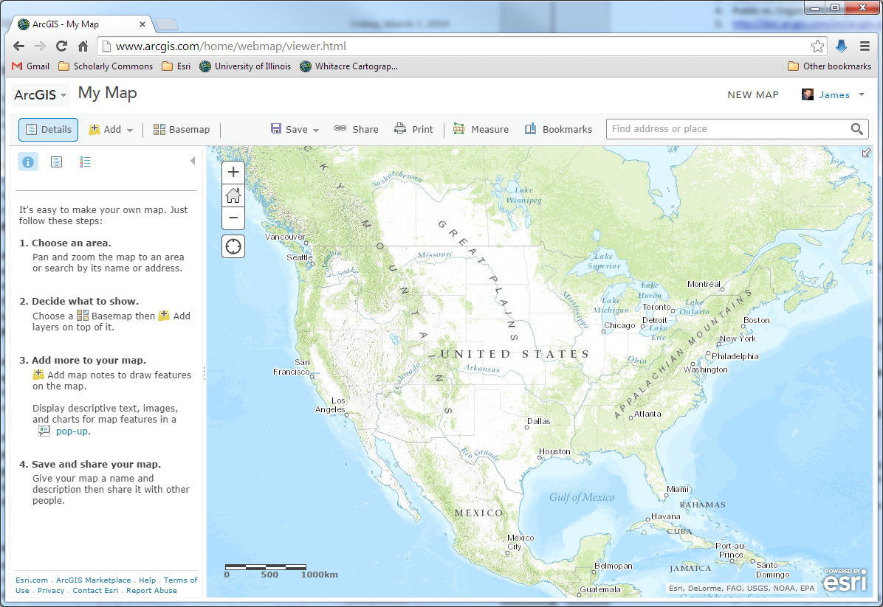
ArcGIS Online
Creating Online Maps

Slide 13
What is ArcGIS Online?
Part of the ArcGIS platform
Cloud-based web software
Public vs. Organizational accounts
http://doc.arcgis.com/en/arcgis-online/reference/what-is-agol.htm

Slide 14
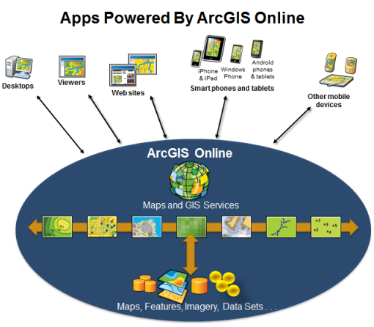
ArcGIS Online = Connect Your Maps
Use, create, and share interactive web maps, apps, and data

Slide 15
What is an ArcGIS Web Map?
Interactive display of geographic information
Opens in a standard internet browser (IE, Firefox, Chrome, etc.), mobile devices, and other ArcGIS map viewers
Contains:
Basemaps and Layers
Legend and navigation tools
Saves web maps to your ArcGIS Online account

Slide 16
An ArcGIS Web Map

Slide 17
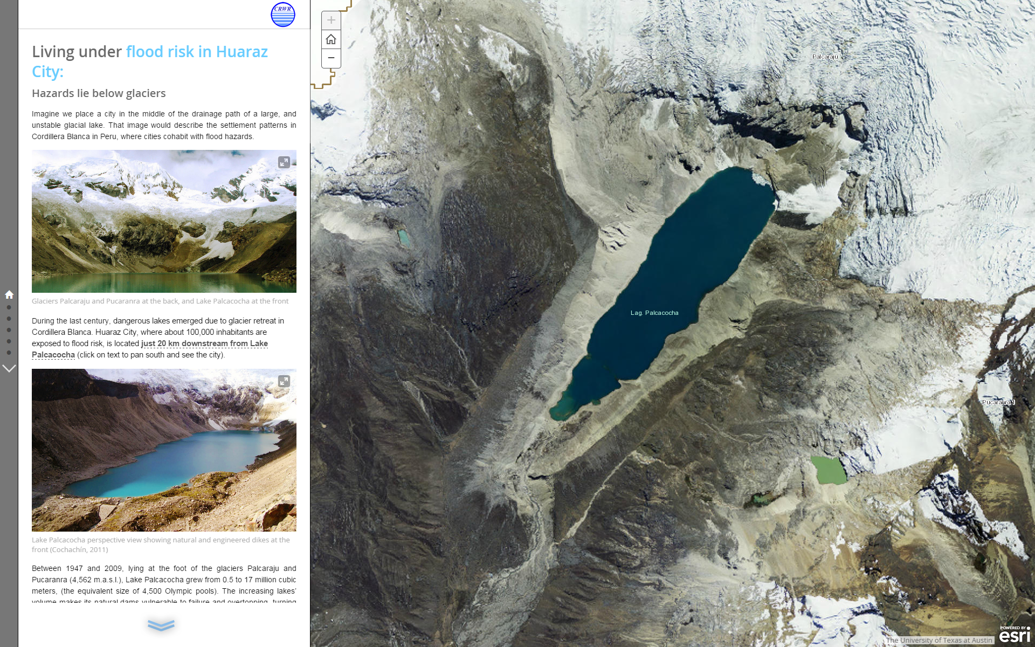
Story Maps

Slide 18
Learning Objectives
Understand how maps enhance research and stories
Introduction to Story Maps
Create an ArcGIS Online Story Map
View Story Map examples

Slide 19
A story about a Story Map…

Slide 20
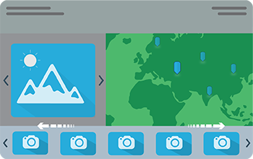

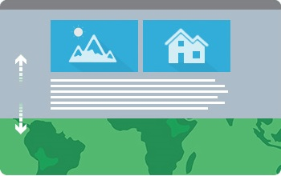
What is a Story Map?
“Esri Story Maps let you combine authoritative maps with narrative text, images, and multimedia content. They make it easy to harness the power of maps and geography to tell your story.”
-From: http://storymaps.arcgis.com/en/

Slide 21
Why Use a Story Map?
Many Purposes:
Community engagement
Digital Humanities
Academic Presentations

Slide 22
What Makes a Good Story Map?
Story Map
Compelling Media
Good web maps
Strong Idea

Slide 23
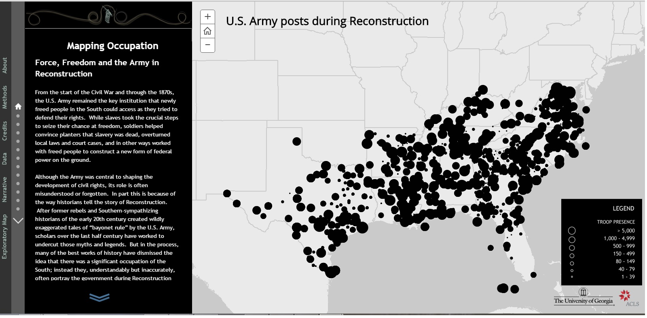
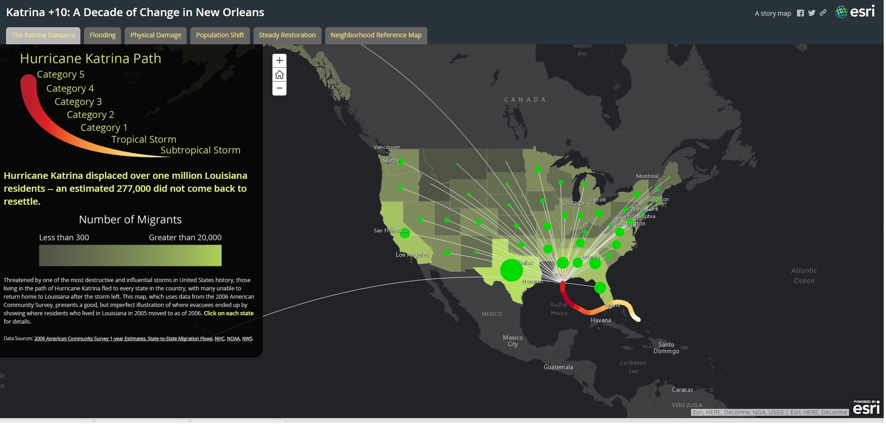
What Does a StoryMap Look Like?
http://storymaps.arcgis.com/en/gallery/#s=0
http://mappingoccupation.org/map/index.html
http://story.maps.arcgis.com/home/item.html?id=597d573e58514bdbbeb53ba2179d2359

Slide 24
Pre-Step: Plan Ahead….
Ideal to plan out your StoryMap ahead of time
Six Steps to Publishing Your Story Map: http://storymaps.arcgis.com/en/articles/publishing-your-story-map/

Slide 25
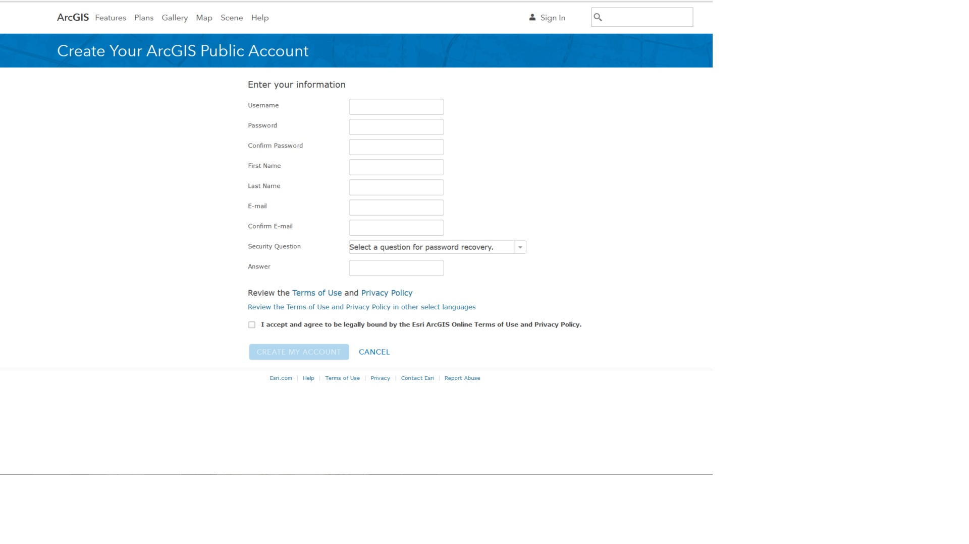
Step 1: Open a ArcGIS Online Account
Go to http://www.arcgis.com/home/index.html
Fill out the resulting form
Log into ArcGIS Online

Slide 26
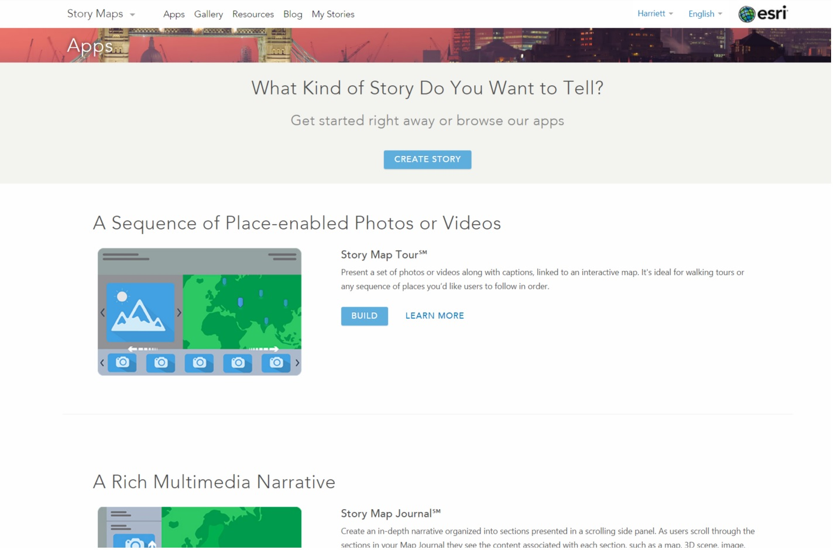
Step 2: Select a StoryMap App format
Log in at http://storymaps.arcgis.com/en/
Click on “Apps” tab in top menu
Scroll through the types of StoryMaps
Find StoryMap Tour and click on “Learn More”

Slide 27
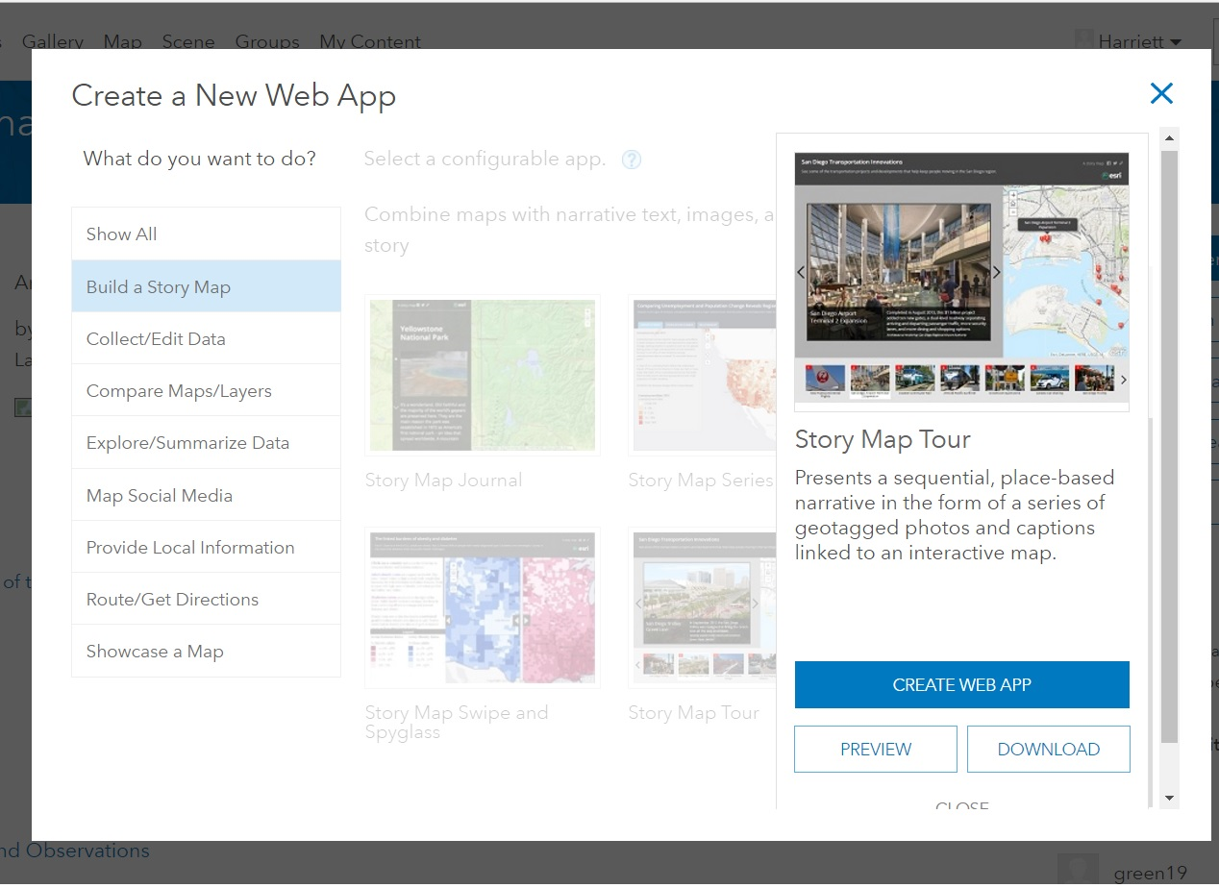
Types of StoryMap
Basic
Map Journal
Tour
Cascade
Series of Maps
Swipe and Spyglass (compare maps)
Crowdsourced Photos
ShortList (travel guide)

Slide 28
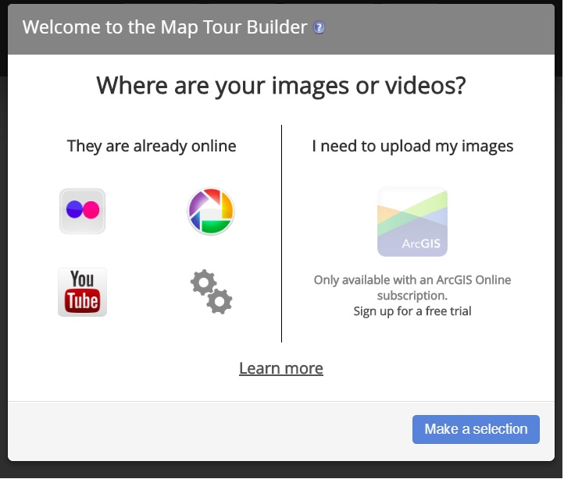
STEP 3: Start a StoryMap
From Apps List” click on “Learn More” for StoryMap Tour
Click on “Build a StoryMap Tour”
In the Welcome box, click on the gears logo to get Advanced Options
Select “Start a New Story Map Tour”

Slide 29
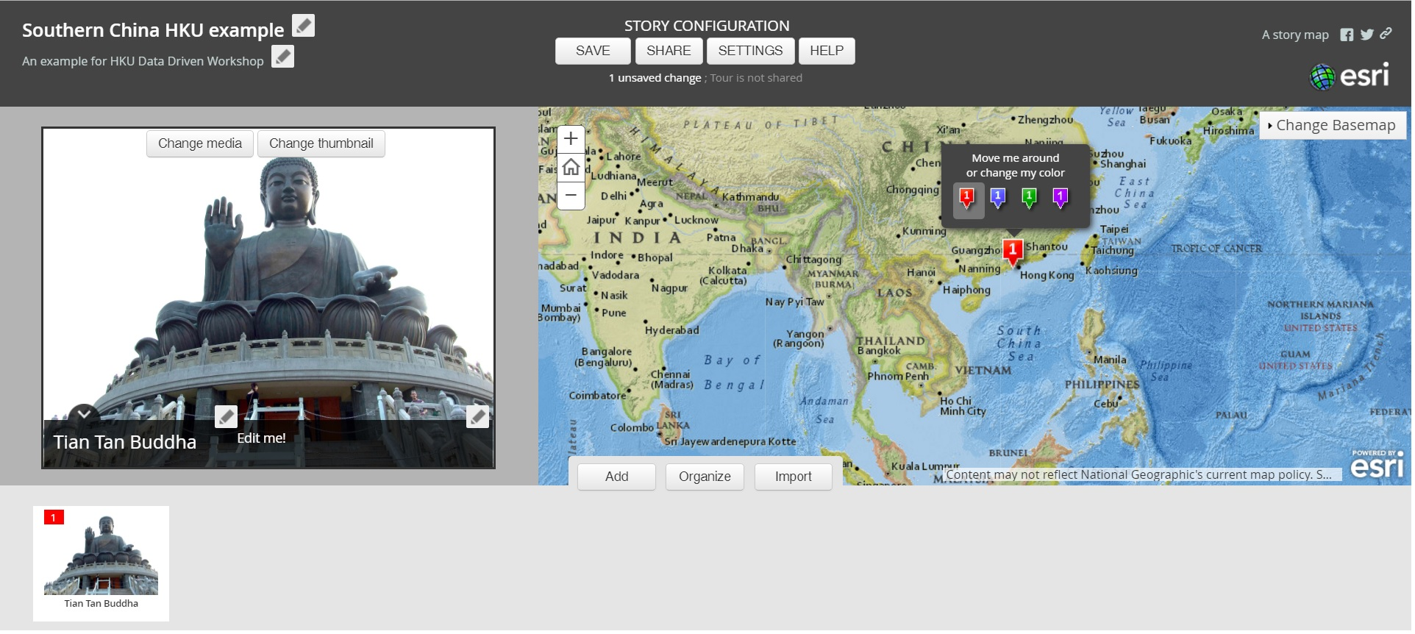
STEP 4: Create a StoryMap!
Add a title, summary, and tags
Configure the map area with a Basemap
Add Tour Points: All media must be online!
Text: http://archive.org , www.hathitrust.org
Images: https://commons.wikimedia.org/wiki/Main_Page
Video and Audio: e.g., YouTube, Vimeo

Slide 30
Open Lab: Build Your Own StoryMap
- Create a Story Map of your home town with 3 locations
http://storymaps.arcgis.com/en/

Slide 31
Additional Exercise:
Explore the ArcGIS Online Web Interface and Create a Basic Map

Slide 32
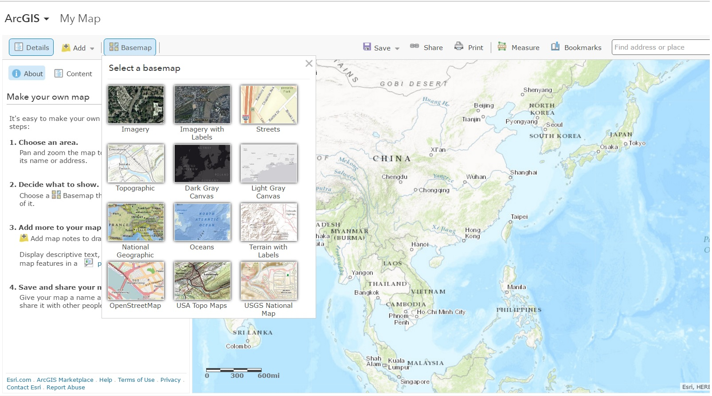
Step 1: Create a New Map
Log into ArcGIS Online at http://www.arcgis.com/home/index.html
Click on “Make a New Map”
Pan and zoom the Map Viewer to where you want to create a map
Click on the BaseMap Tab to select the BaseMap

Slide 33
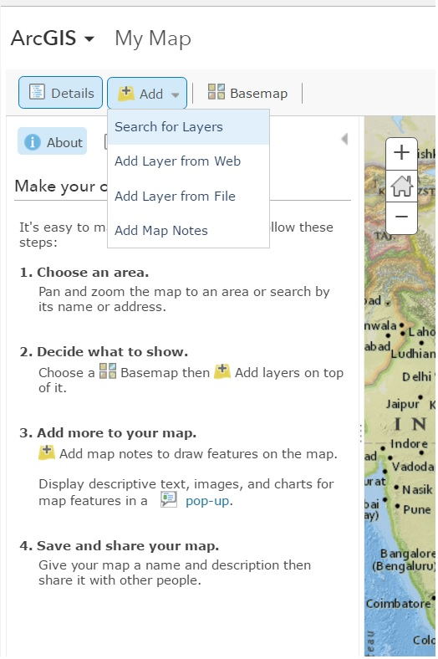
Step 2: Add Content
Click “Add” tab, select “Search Layers” to find ready-to-use layers to add to your map
Click “Add” next to each pre-loaded layer you want to add.
Railway routes
Wind and Weather patterns
Flood Zones
Click “Done With Layers”
Click on Save button to save Web Map

Slide 34
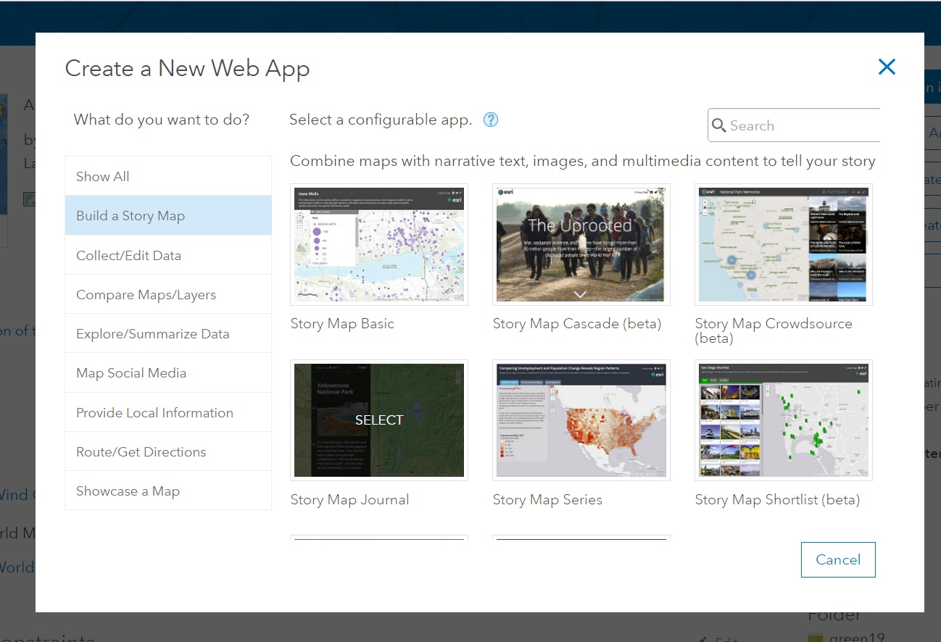
Advanced: Build a StoryMap With ArcGIS Online Web Map
Log into ArcGIS Online > Click on “My Content”
Find your previously created Map
Click on “Create a Web App”
Select “Build a Story Map”
Select the type of StoryMap you want to use

Slide 35
Examples of Good Story Maps
Childs Frick Abyssinian Expedition 1911-12: http://carnegiemnh.maps.arcgis.com/apps/MapTour/?appid=1a374d71166d478f865eefb04a08654b or http://www.carnegiemnh.org/mammals/storymap/#Expedition_Map
After the storm: Powdermill Nature Reserve's response to a unique research opportunity: http://carnegiemnh.maps.arcgis.com/apps/MapJournal/index.html?appid=2e87220ab2d346dc9b3aa9f09075477b&webmap=21c887214a64419190a80259327f02fb
Decisive Moments in the Battle of Gettysburg: http://storymaps.esri.com/stories/2013/gettysburg/
The Assassination of Abraham Lincoln: http://story.maps.arcgis.com/apps/MapTour/?appid=c50be5615f024cc482ccb88222a8719d
Elephant Poaching: http://wcs-global.maps.arcgis.com/apps/MapJournal/?appid=6d920df507b5430fbd2c69c74ed21c6f
Mountains of Fire (3D maps!): http://story.maps.arcgis.com/apps/MapJournal/?appid=4c77a56bbcd743b69232cf3fd9c7a61c
View More StoryMaps: http://storymaps.arcgis.com/en/gallery/#s=0

Slide 36
Other Easy Mapping Tools….
NeatLine: http://neatline.org
Google Maps: http://maps.google.com/
HistoryPin: http://www.historypin.com
WorldMap: http://worldmap.harvard.edu/
Quantum GIS: http://qgis.com
Learn more at:
http://guides.library.Illinois.edu/gis

Slide 37
Thank You to James Whitacre GIS Specialist at University of Illinois! http://guides.library.illinois.edu/gis

Slide 38

QUESTIONS?
Harriett Green
English and Digital Humanities Librarian
University of Illinois at Urbana-Champaign
green19@Illinois.edu
Nicholas Weber
Assistant Professor, Information School
University of Washington
nmweber@uw.edu

